Slide 1
Common Data problems
Inconsistent column names
Missing data
Duplicate data
Outliers -> Boxplot
Tidy data -> shape [pivot – row to columns| melt – column to rows]
pd.melt(frame=df, id_vars='', value_vars='', var_name='', value_name=‘’)
df.pivot(index='', columns='', values=‘’)
df.pivot_table(I,c,v, aggfunc=no.mean)Duplicate Rows
Unexpected Column types
astype()
to_date()
pd.to_numeric(df[], errors=‘coerce’)
Require joining of different dataset

Slide 2
Missing data handling [NaN value]
dropna(axis={0,1}, how={'any’,'all'}, thresh=None, inplace=True)
fillna(value={'col1': 1, 'col2': 3},
method={‘backfill’, ‘bfill’, ‘pad’, ‘ffill’, None}
axis={0 or ‘index’}
Inplace={True, False}, limit=1)
interpolate(method={'polynomial','linear’, 'pad'}, order=2, limit=2)
replace(method={‘pad’,‘ffill’,‘bfill’})
replace(0, 5)
replace([0, 1, 2, 3], 4)
replace([0, 1, 2, 3], [4, 3, 2, 1])
replace([1, 2], method='bfill’)
replace({0: 10, 1: 100})
replace({'A': 0, 'B': 5}, 100)
replace({'A': {0: 100, 4: 400}})
Notes:
Thresh = Require that many non-NA values.
Limit = 2 Replace first 2 NaN element
Pad = replace previous value, works with limit

Slide 3
Combining, Joining and Merging
df1.append(df2, ignore_index=True)
pd.concat([df1, df3], join={'inner','outer'}, keys=['s1', 's2’], ignore_index )
join(on=, how= {'left','right,'outer','inner’})
df1.join(df2)
merge(how=,on=,left_on=,right_on=)
df1.merge(df2)
assign(new_col=func) => Assign new columns to a DataFrame.
df.assign(temp_f=df['temp_c'] * 9 / 5 + 32)
s1.update(s2)

Slide 4
Handling Imbalanced Dataset
Under sampling the majority classes – through away data
Over sampling the minority classes – duplicate data
Over sample only the training data and not test data
imblearn.over_sampling | under_sampling
over_sampling:
SMOTE - – Synthetic Minority Over Sampling Technique (Fake data)
RandomOverSampler
KMeansSMOTE
under_sampling:
TomekLinks
RandomUnderSampler

Slide 5
Model validation

Slide 6
Cross validation

Slide 7
Regression Algorithms
LinearRegression
Ordinary Least Squares (OLS)

Slide 8
Classification Algorithms

Slide 9
Clustering Algorithms
AgglomerativeClustering(n_clusters, affinity={euclidean,l1,l2,manhattan,cosine})

Slide 10
Tree based Algorithms
criterion = quality of a split
Entropy – Information gain
-> low = when in a node all are positive or negative or same class
-> high = when half true and half false
Gini - impurity

Slide 11
Ensemble Algorithms
Better accuracy
Avoid overfitting
Reduces bias variance problems

Slide 12
Bagging vs Boosting
Set of week learner to get better result
Bagging or bootstrap aggression
-> same model different subset of data
-> Random sampling
Boosting
-> Particularly select the wrong data points and other data set
-> voting

Slide 13
NLP

Slide 14
Finding and handling Outliers

Slide 15
Finding Outliers
Box plot
df.boxplot(column=‘polulation', by=‘country’)

Slide 16
Feature Selections

Slide 17
Important packages
Import glob -> find files inside folder

Slide 18
Important Functions
Pipeline - imblearn.pipeline

Slide 19
Regression model Example
Given X what is Y?
Predicting continues values
Predicting annual sales
Predicting Housing price
Predicting Rainfall

Slide 20
Classification model Example
Binary and Multi-class classification – True | False
Credit Card Fraud Detection
Predicting Winner of world cup
Predicting will it Rain or not
Predicting spam or ham
Predicting Cat or dog
Predicting Hand written digits

Slide 21
R2
Coefficient of determination
A measure of how well Y [predicted] is explained by X[independent ]
Value close to 1 is good result | close to 0 not

Slide 22
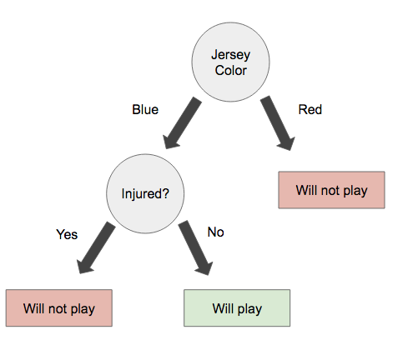
Decision Tree

Slide 23
P-Value

Slide 24
Data preprocessing
StandardScaler
min_max_scaler

